Slide 1


Electrical Behavior Prediction Of An Inverter Using Machine Learning Algorithms
Gabriel L. Jacinto
Cristina Meinhardt
Department of Informatics and Statistics,
Federal University of Santa Catarina

Slide 2

Machine Learning and Microelectronics
INTRODUCTION
Technology Complexity
Design Process Variability
Affects
Delay
Power Consumption
Machine Learning
Thus, reducing cost of production*
Possible Solution
Simulations
(can take very long)
In order to avoid
* CMOS, SOI and FINFET technologies, for example

Slide 3
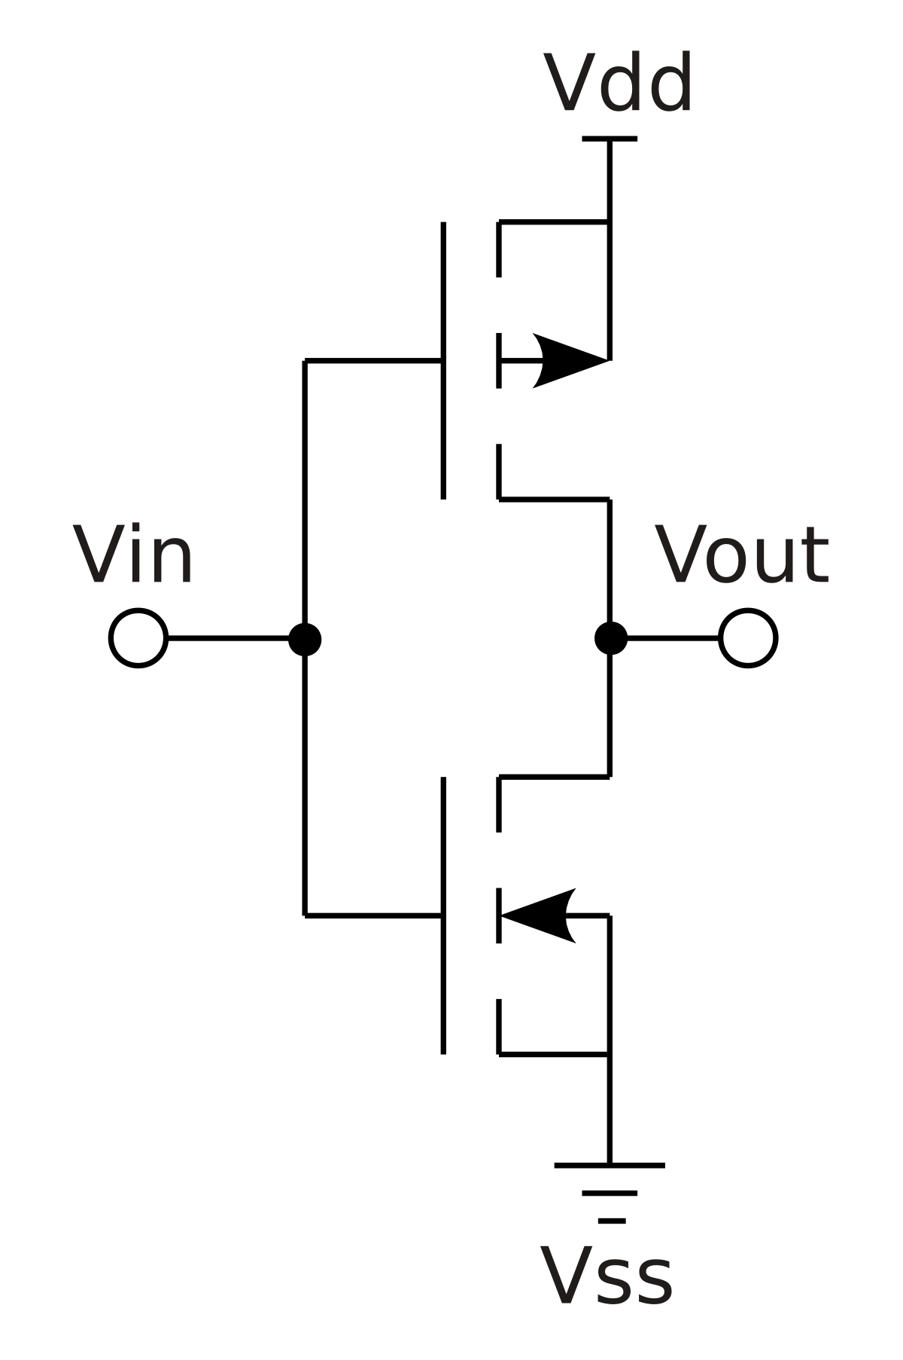






Objective
INTRODUCTION
CMOS INVERTER CIRCUIT
SUPERVISED ALGORITHMS
DEPENDENT VARIABLES
MACHINE LEARNING MODELS
PREDICTION
Tp_{L}H
SIMULATION DATA
Multiple Linear Regression
Tp_{H}L
(temperature, voltage, process variability...)
Support Vector Regression
Decision Trees
Random Forest
Energy
https://pt.wikipedia.org/wiki/CMOS
Notes:
First-case study on a CMOS inverter (put scheme) to predict propagation delay and energy using temperature, voltage, and process variability.
We used four popular supervised regression algorithms (SVR, MLR, DT, RT), to see how simpler algo performs.
Colocar as ferramentas utilizadas

Slide 4
Performance Measurements
INTRODUCTION
ROOT MEAN SQUARE ERROR
MEAN ABSOLUTE ERROR
RMSE(X, h) = √∑_{i=1} [ h(x^{(i)}) - y^{(i)} ]²
MAE(X, h) = ∑_{i=1}|h(x^{(i)}) - y^{(i)}|
m
m
m
m

Slide 5
Feature Extraction
METHODOLOGY
Dependent Variable | Tp_{H}L | Tp_{L}H | Energy
Independent Variables | NMOS Vth0
 | PMOS Vth0
 | Temperature
 | Voltage
 | Width PMOS
 | Width NMOS
 | Length
 | Energy | Tp_{H}L | Tp_{H}L
 | Tp_{L}H | Energy | Tp_{L}H
1000 Transient Simulations of 20ns with step of 0.1ns
Variation Range
Temperature (ºC):
-25, 0, 50, 75, 100
Width PMOS (nm):
70, 140, 280, 350, 420
Width NMOS (nm):
70, 140
Length (nm):
20, 32, 40
Voltage (V):
0.6, 0.7, 0.8, 0.9
120,954 Observations
80% Training Set
20% Test Set

Slide 6
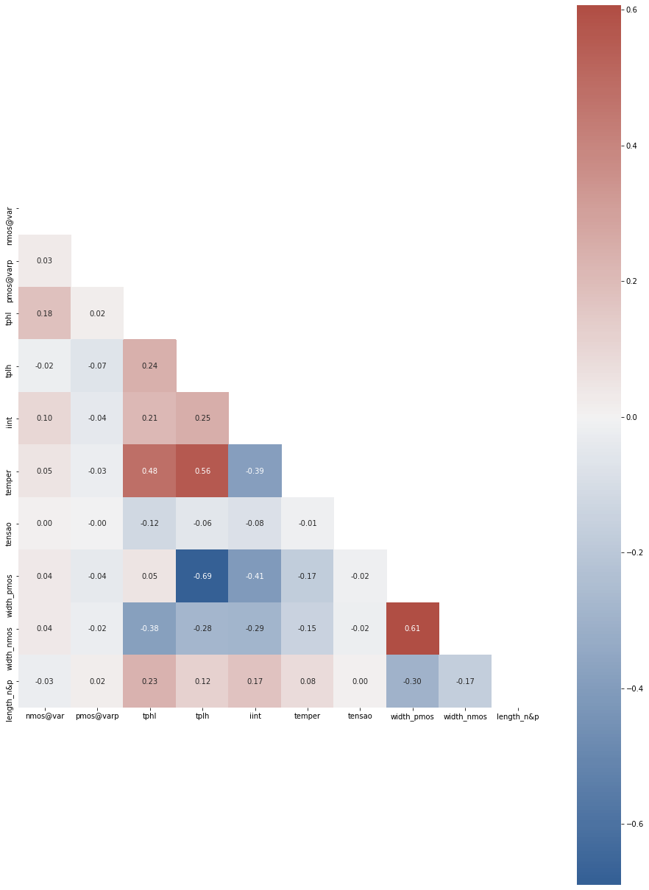
Correlations
and Scaling
METHODOLOGY
STANDARDIZATION SCALING
X’ = (X - μ)
σ

Slide 7
Prediction Errors
RESULTS AND DISCUSSION
Model | Dependent Variable
 | tp_{H}L (ps) |  | tp_{L}H (ps) |  | Energy (fJ)
 | RMSE | MAE | RMSE | MAE | RMSE | MAE
MLR | 1.26 | 0.94 | 4.33 | 3.14 | 0.20 | 0.15
SVR | 12.16 | 11.68 | 22.08 | 20.54 | 0.44 | 0.37
DT | 3.46 | 2.73 | 10.13 | 7.78 | 0.42 | 0.34
RF | 3.46 | 2.73 | 10.13 | 7.78 | 0.42 | 0.34
tp_{H}L min: 6.34ps, max: 42.94ps
tp_{L}H min: 4.24ps, max: 67.20ps
Energy min: -2.68fJ, max: -0.83fJ

Slide 8
The Best Algorithm and Future Works
CONCLUSION
Multiple Linear Regression
Other models: poly kernel for SVR, neural networks architectures
Other linear and non-linear correlations (Pearson vs Spearman vs Kendall)
More fine tuning to minimize the cost function
Try other technologies and circuits

Slide 9
Electrical Behavior Prediction Of An Inverter Using Machine Learning Algorithms
Gabriel L. Jacinto (gabriellimajacinto@gmail.com)
Cristina Meinhardt (cristina.meinhardt@ufsc.br)
Department of Informatics and Statistics,
Federal University of Santa Catarina

Slide 10
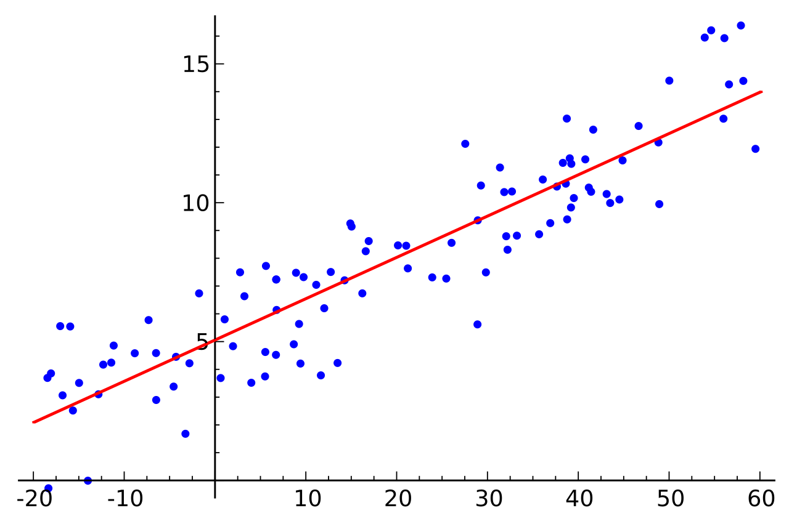
Background in Machine Learning Techniques
APPENDIX
Multiple Linear Regression (MLR)

Slide 11
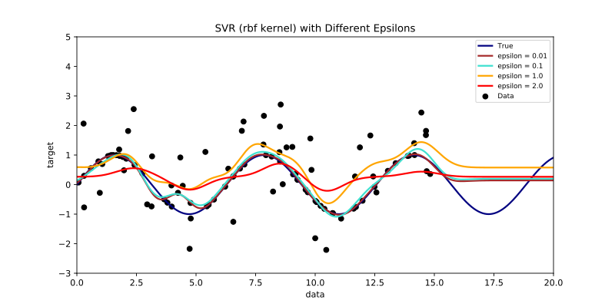
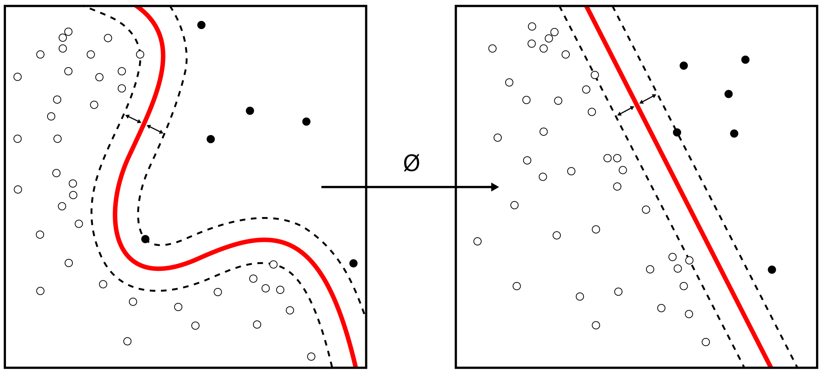
Background in Machine Learning Techniques
APPENDIX
Support Vector Regression (SVR)

Slide 12

Background in Machine Learning Techniques
APPENDIX
Decision Trees (DT) and Random Forest (RF)
https://en.wikipedia.org/wiki/Random_forest

